Slide 1


HYDROINSIGHT
SMART . WATER . TECH
By CODE TRUCHEON

Slide 2

INTRODUCTION
Water scarcity is a growing problem worldwide, with the average person's water footprint reaching 1,385 cubic meters per year. To tackle this issue, we propose harnessing the power of digital technology and developing an innovative app.

Slide 3
Calculating Water Footprints Made Easy
The Problem
The Solution
The Benefits
Measuring individual water footprints accurately has always been a challenge, especially with varying water usage across different products.
Our app utilizes digital technology to calculate and track water footprints, making it effortless for individuals to understand and manage their water usage.
With the app, users can reduce their water footprint, detect leaks, and identify other potential issues in water systems. This not only saves water but also helps save money in the long run.

Slide 4
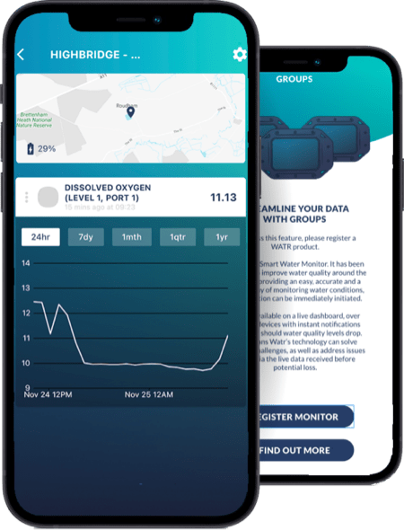

Challenges Ahead
1
Accuracy and Reliability
2
User-Friendly Interface
Ensuring the app provides accurate and reliable data is crucial to its success and user adoption.
The app needs to be intuitive and easy to navigate, allowing users to effortlessly track and manage their water usage.
3
Cost Considerations
The development and maintenance costs of the app must be evaluated to ensure its long-term feasibility.

Slide 5
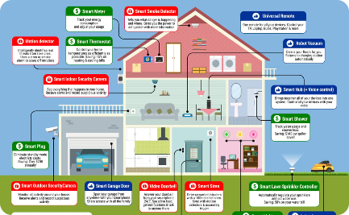


Applying Digital Innovation to Water Systems
Data Monitoring
Leak Detection
Increasing Awareness
Using sensors and real-time data, the app accurately measures the flow of water in homes and businesses.
Identifying cracks and leaks in water pipes helps users address potential issues and prevent water loss.
By promoting water conservation and sharing insightful reports, the app educates and engages users in sustainable water management practices.

Slide 6
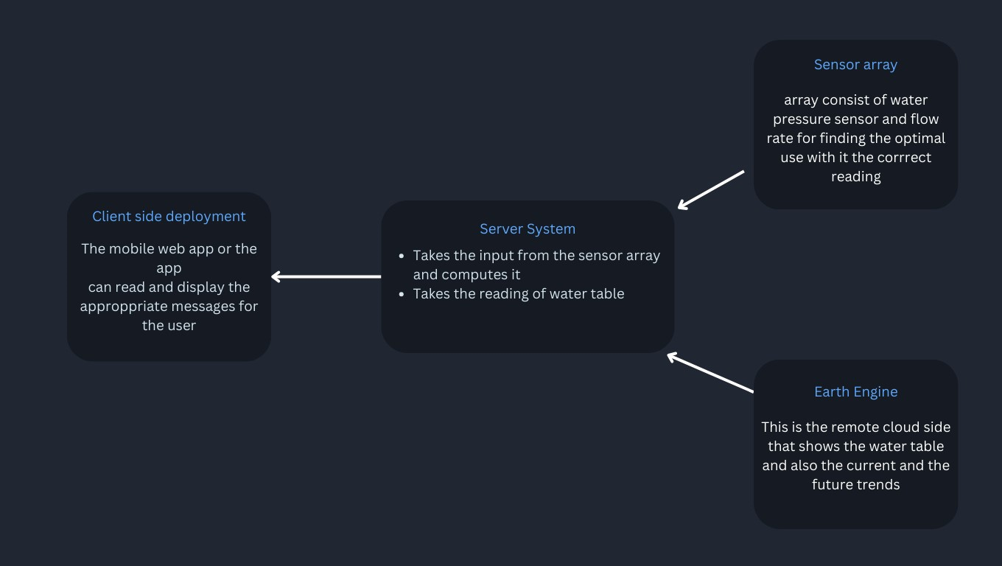

Slide 7
Unlocking the Potential of Data
1
Data Collection
The app collects precise water usage data, enabling users to analyze their consumption patterns and make informed decisions.
2
Goal Setting
Users can set personalized water usage goals and track their progress, encouraging conscious water consumption.
3
Effective Resource Management
Businesses, governments, and individuals can leverage the app's data and insights to optimize water resource allocation and minimize waste.

Slide 8
Building a Sustainable Future
Smart Water Systems
Real-Time Notifications
Community Collaboration
The app integrates with smart water systems, enabling efficient water management and reducing overall consumption.
Users receive alerts about potential leaks or unusual water flow, empowering them to take action promptly.
The app fosters collaboration among communities, creating a collective effort to conserve and sustain water resources.

Slide 9
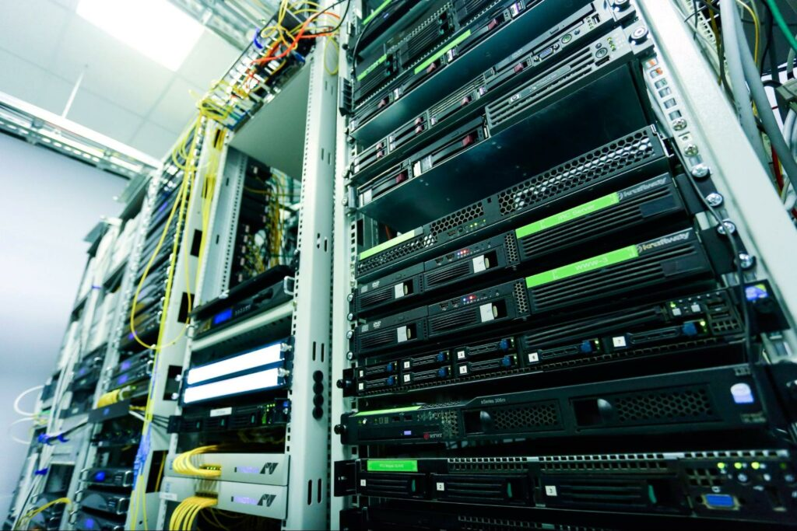
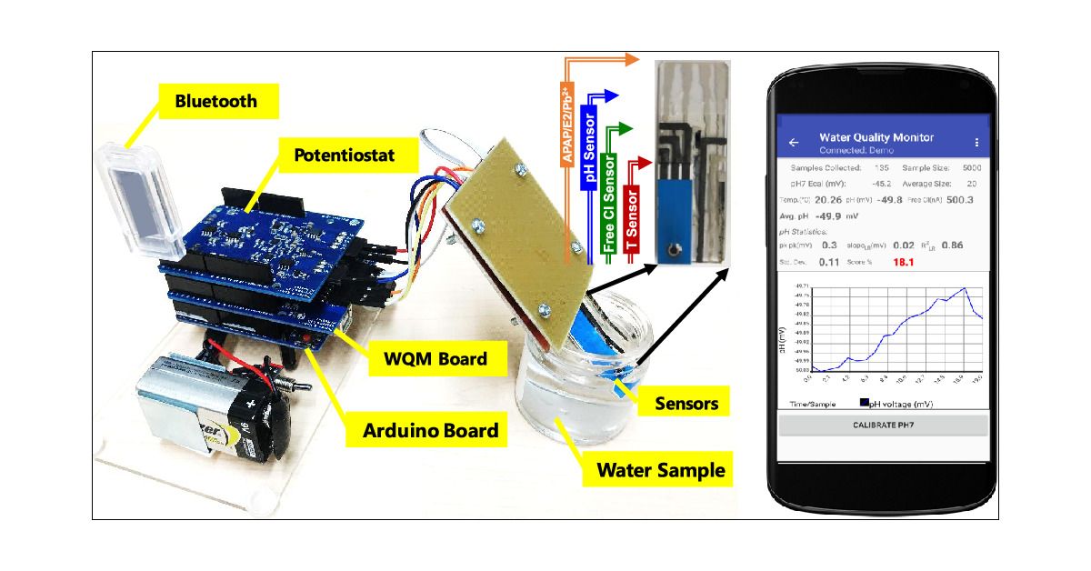
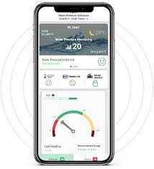
Our Infrastructure
Server System
Sensor Array
Mobile app
The server system is a standalone computer that collects data from the sensor array and stores it in a database. It also provides a web app that users can use to view the data and track their water usage.
The sensor array is a network of sensors that are placed at various points in the water system. The sensors measure the water pressure, flow rate, and water quality.
The mobile app allows users to view the data from the server system on their smartphones or tablets. It also provides notifications of low water pressure or leaks.

Slide 10
Conclusion
The use of digital technology to calculate water footprints in real-time offers a promising solution to the water scarcity problem. By developing an app that monitors water flow, detects leaks, and enhances water management practices, we can empower individuals, businesses, and governments to conserve water, save money, and build a sustainable future.

Slide 11

The Team
1.Leno Simon Ananad
2.Leonard K.B
3.Manu K.B
4.Manuel Siju
5.Neha Paulson
6.Neha Shaju
team.code.truncheon
find us at:
https://github.com/codetuch

Slide 12

Reference
blahblahblah
blahblahblah

